Slide 1
Transposons
buffer distruptive
transpositions
caused by
carry
Defense mechanism
cassettes
Increased genome size
spreads
helps competion
and defense on
correlates with
Particle-associated lifestyle
A deep-ocean microbial community

Slide 2
correlates with
Particle-associated lifestyle
helps competion
and defense on
Increased genome
size
Defense
mechanism
cassettes
spreads
buffer distruptive
transpositions
cause by
carry
Transposons
A deep-ocean microbial community

Slide 3
Transposons
spreads
carry
helps competion and defense on
The switch to particle lifestyle
Defense
mechanism
cassettes
A deep-ocean microbial community

Slide 4
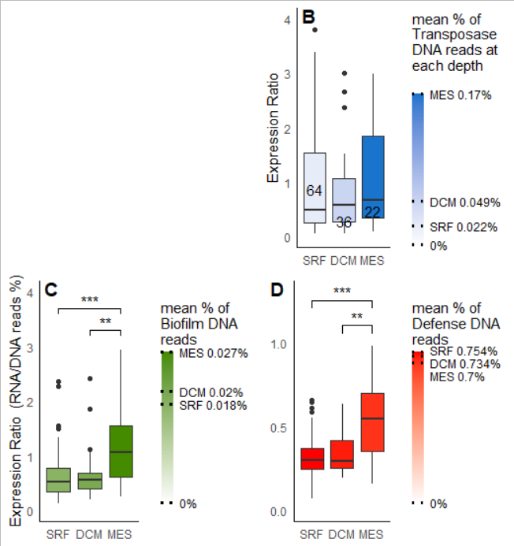

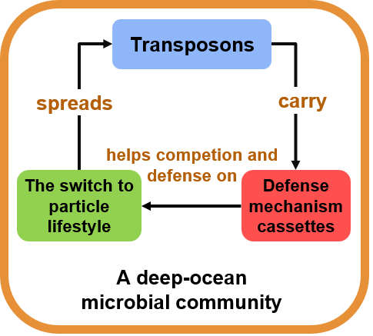

Slide 5
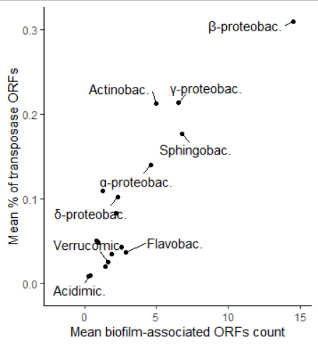
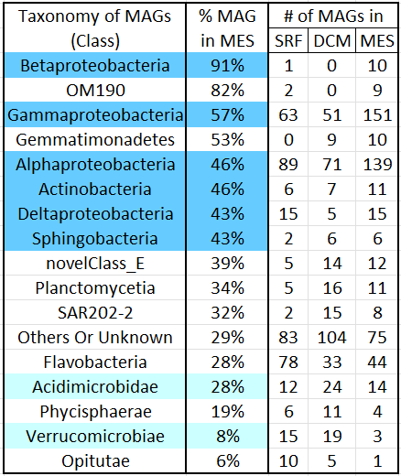
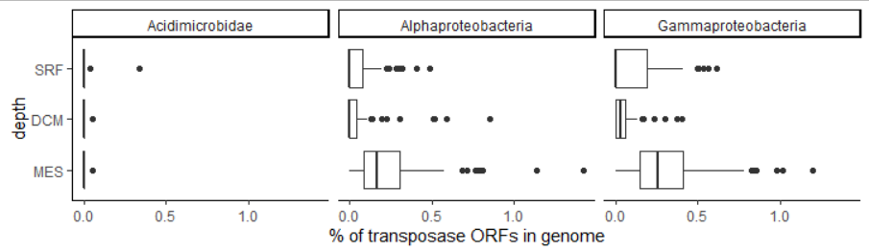







Slide 6
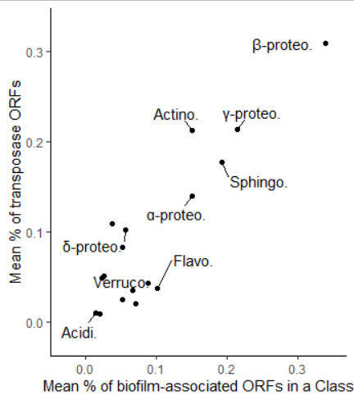







Slide 7
